Slide 1



Edge Computing
23CSE362
Group 21
EDGE COMPUTING-BASED REAL-TIME SCHEDULING FOR DIGITAL TWIN FLEXIBLE JOB SHOP WITH VARIABLE TIME WINDOW
Jin Wang et al
[ TASK SCHEDULING ]
DHRUSHEEK RISHI MENON [CB.SC.U4CSE23716]
PREETHI KANNAN [CB.SC.U4CSE23738]
SREEPATHY JOSHY [CB.SC.U4CSE23748]
THILAGAN INIYAVAN [CB.SC.U4CSE23750]

Slide 2
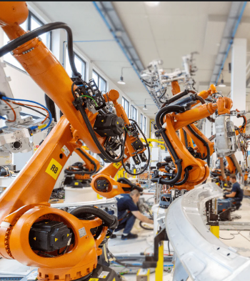
PROBLEM STATEMENT
In a fixed production line, scheduling is relatively simple because products always follow the same sequence of machines. But in a flexible job shop like ours, where jobs can take different routes and disturbances such as rush orders or machine breakdowns are common, scheduling becomes far more complex. Traditional static or cloud-based methods are too slow and unstable. That's why we need real-time scheduling, making this an edge problem

Slide 3
WHY AN EDGE SOLUTION?
Massive sensor data which cloud can't process fast enough
Cloud computing adds round-trip delays, increasing latency
more the disturbance, more frequently updates needed
with edge computing:
Edge devices filter and preprocess data locally, sending only relevant info to the cloud, saving time and bandwidth.
Enables instant schedule updates and only in required places

Slide 4
THE EDGE SOLUTION
Our goal is to build a software-only demo of a production line scheduling system.
The system will:
Keep track of a list of production jobs and the availability of each simulated machine.
use a genetic algorithm running on a simulated edge device (our PC) to decide how to schedule the jobs.
Send start commands to simulated PLCs(Programmable Logic Controller) in real time so the jobs are carried out.
Make sure work is spread fairly across multiple production lines to avoid bottlenecks.

Slide 5
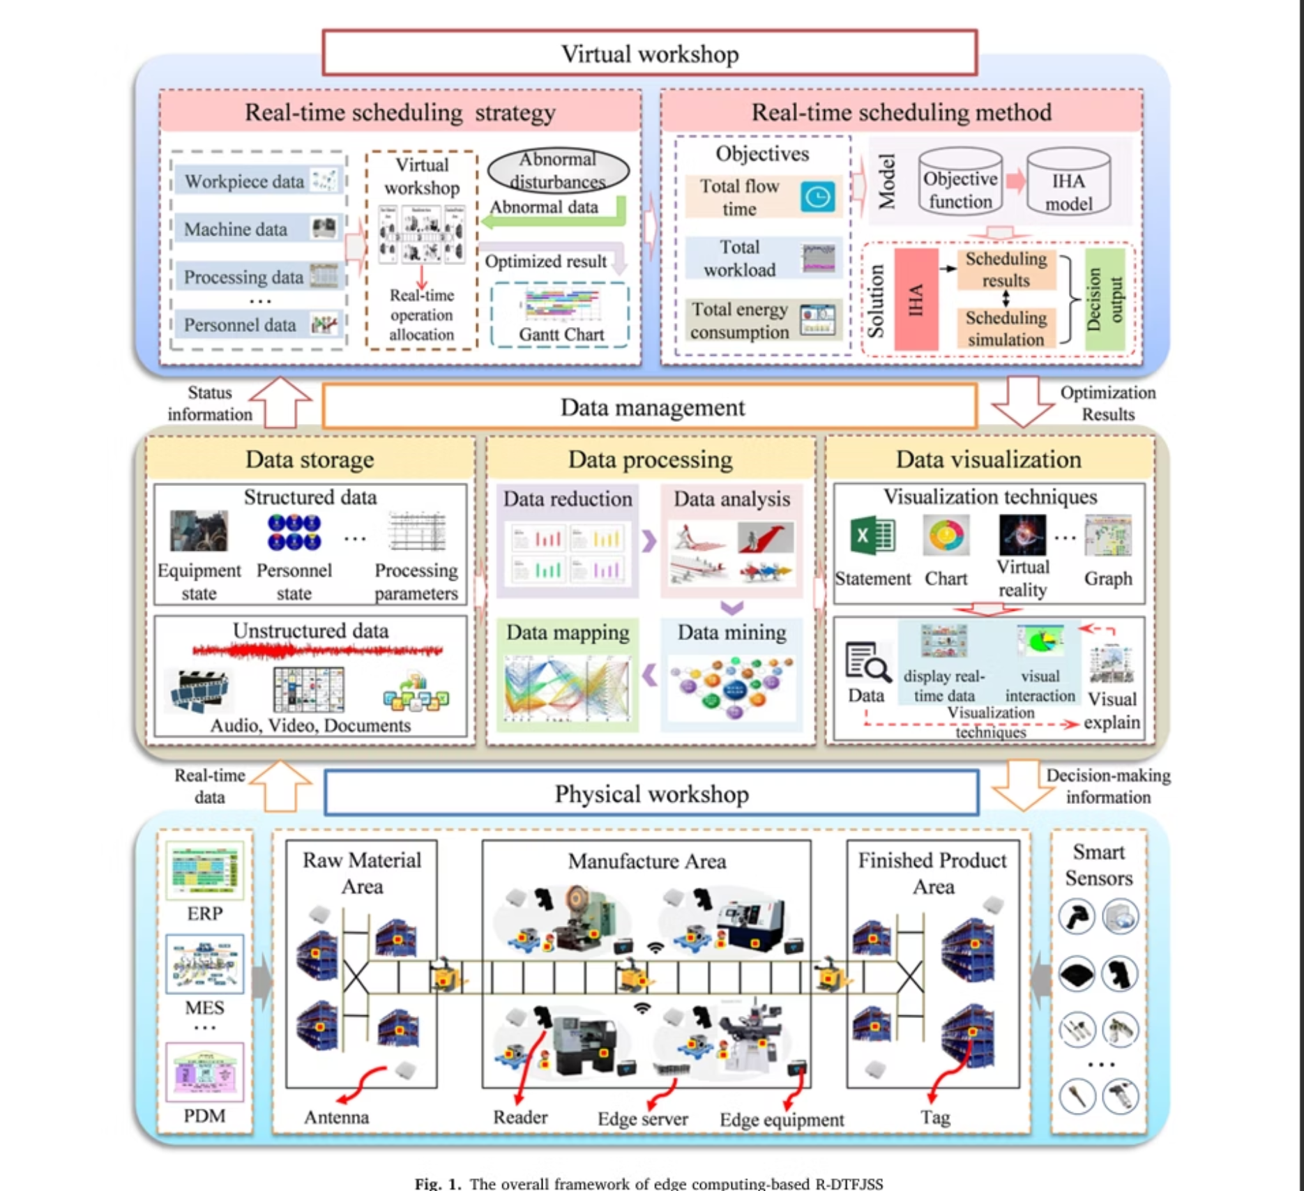
R-DTFJSS (Real-time Digital Twin Flexible Job Shop Scheduling)
Physical Workshop
Data Management
Virtual Workshop

Slide 6
Physical Workshop
Real-Time Data Acquisition:Physical workshops are equipped with smart sensors (for parameters like vibration, temperature, etc.) and RFID devices to automatically collect data about machines, workpieces, materials, and personnel in real time.
Edge Data Pre-Processing:Edge equipment and edge servers located within the PW locally pre-process collected data to filter out redundant, misleading, or inconsequential information. This ensures that only essential, actionable data is forwarded for further processing.
Data Management Module
Acts as a bridge between PW and VW. It includes:
Data Storage:Retains both structured and unstructured manufacturing data.
Data Processing:Cleans, analyzes, and transforms data into valuable insights.
Data Visualization:Provides real-time graphical representations for monitoring and decision-making.

Slide 7
Virtual Workspace
Digital Twin Mirror: The VW serves as a real-time digital replica (digital twin) of the PW, receiving continuous, up-to-date data streams from the data management module to simulate actual production conditions and events.
Dynamic Scheduling and Control: VW uses real-time data to perform dynamic, adaptive scheduling (RS), rapidly recalculating and reallocating operations when disturbances or machine breakdowns occur.
Optimized Decision-Making: Employs advanced algorithms (like Improved Hungarian Algorithm, IHA) to achieve multi-objective optimization—minimizing
Model Assumptions & Limitations
Neglected Transportation Time: The model ignores the time required to move jobs/materials between machines, which can affect real-world scheduling accuracy.
Initial Machine Availability: Assumes all machines start idle and available at scheduling initiation, not accounting for ongoing operations or maintenance.
Known Machine Recovery Times: Assumes precise knowledge of machine breakdown recovery durations, which may vary and be unpredictable in practice.

Slide 8
FLEXIBLE JOB SHOP SCHEDULING (FJSS)
Definition:
Core Characteristics:
A Flexible Job Shop Scheduling Problem (FJSSP) models a manufacturing system comprising n jobs and m machines, where each job consists of a sequence of operations that can be processed on multiple eligible machines, allowing flexible routing.
Routing Flexibility: Each operation can be assigned to one of several candidate machines, introducing combinatorial complexity.
Concurrent Machine Utilization: Machines can process different types of operations; there is no fixed machine-to-operation mapping.
Sequential Constraints: Operations within each job must obey strict precedence relations.
Dynamic and uncertain environment: Real-time disturbances such as machine breakdowns, rush orders necessitate adaptive scheduling.

Slide 9
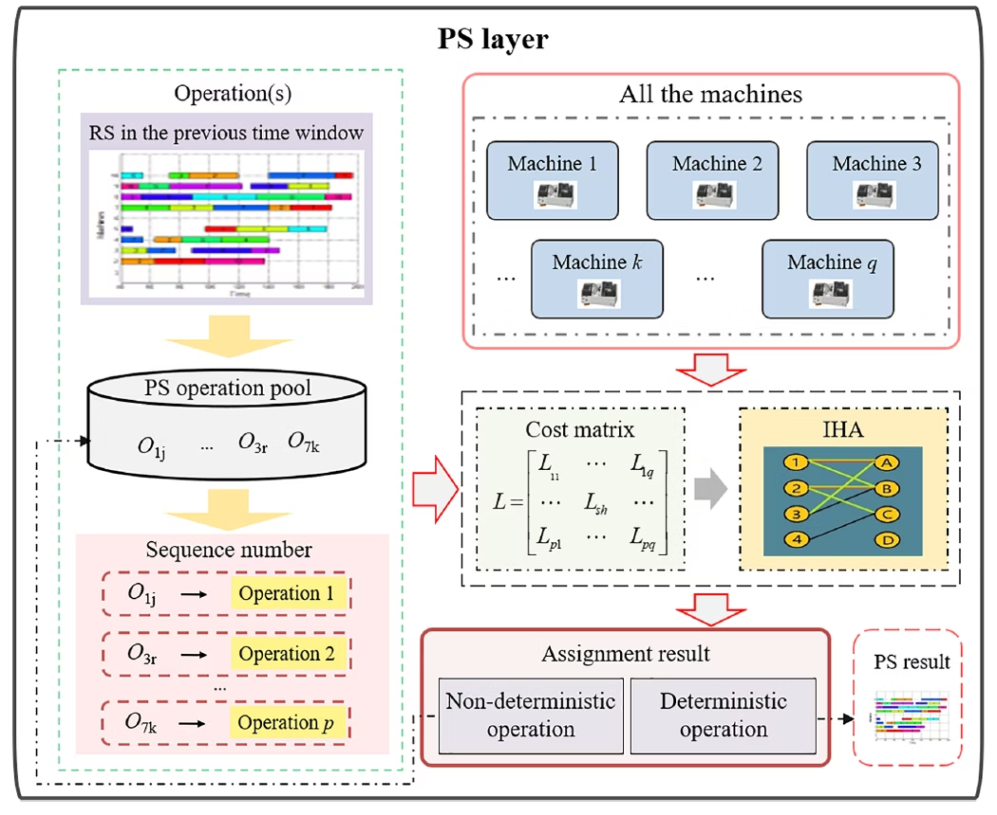
Start with the first unassigned operations in jobs at Tn.
Number the operations and machines.
Construct the cost matrix.
Solve the assignment using IHA.
Assign one operation per machine deterministically to avoid premature commitment.
Put remaining operations back to the operation pool.
Repeat until all operations eligible to start within Tn are assigned.

Slide 10
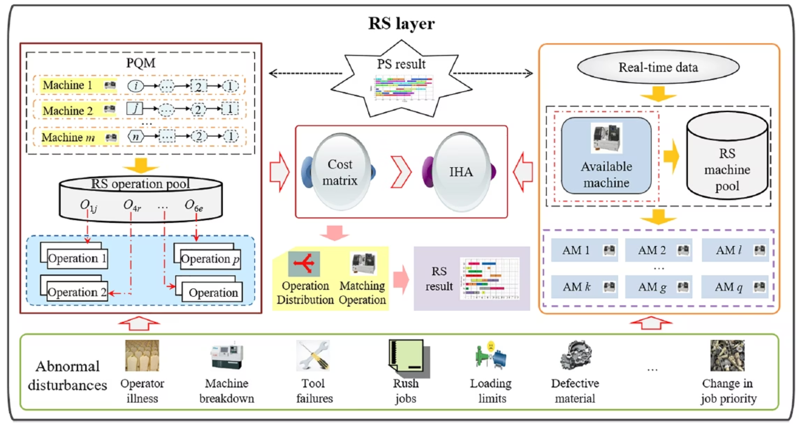

Slide 11
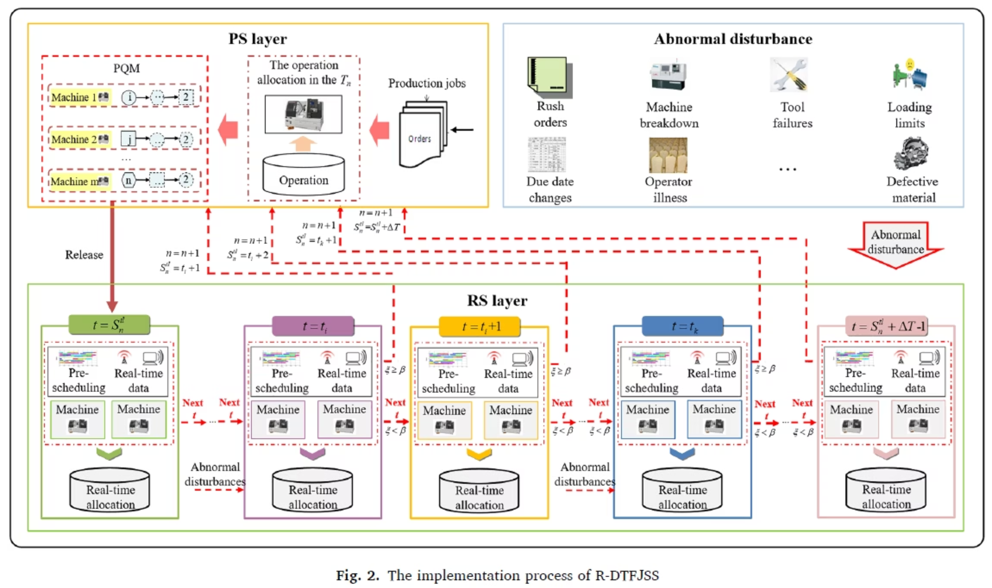

Slide 12
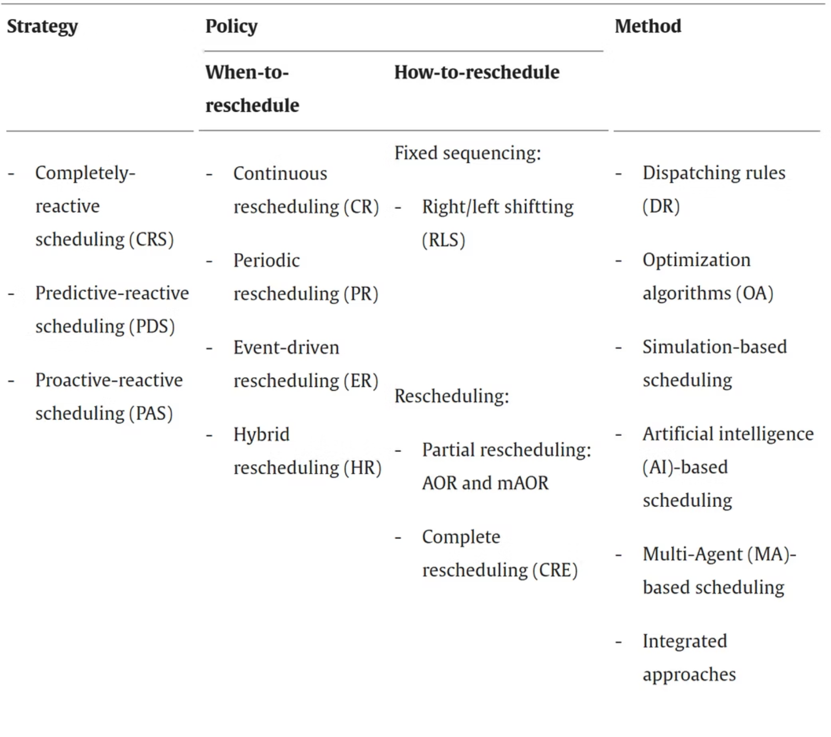
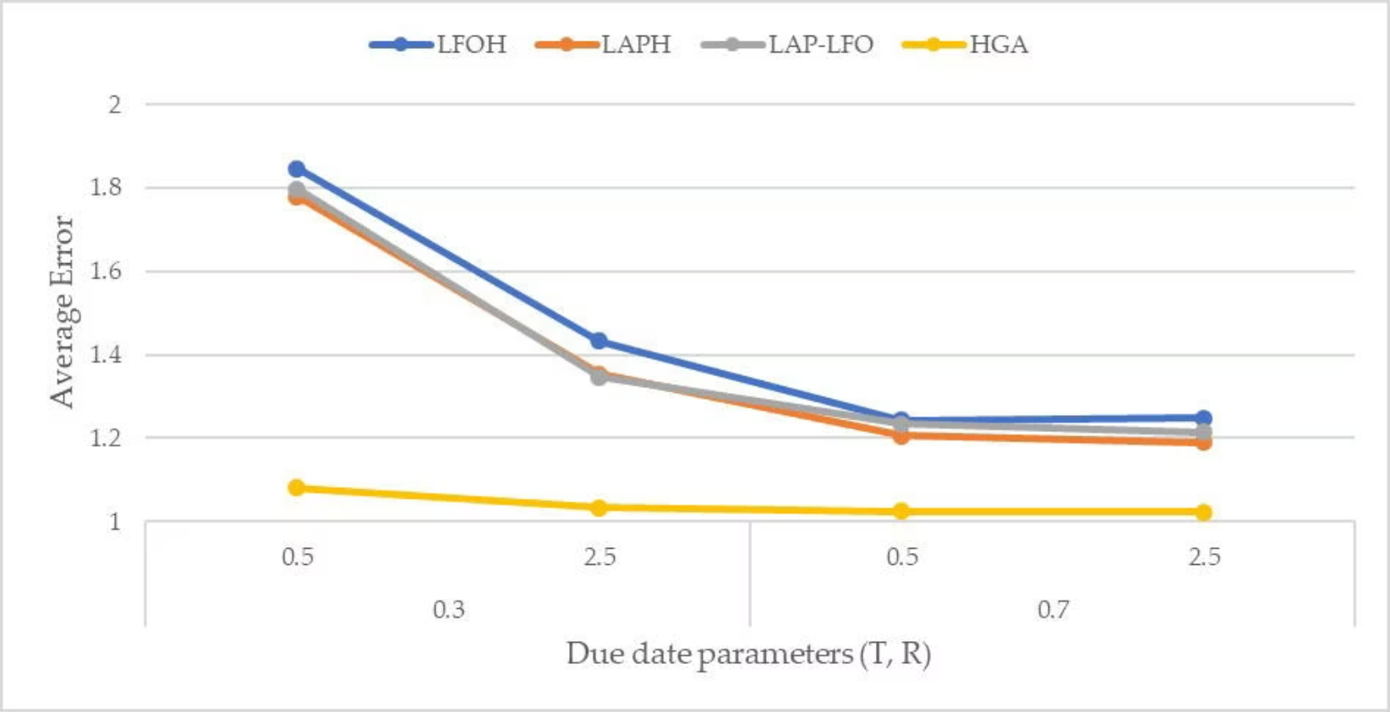
SOTA LITERATURE - GHALER(2020)
Combining proactive planning with reactive rescheduling
Adaptive Scheduling for Uncertainties in Job Arrivals
Active–Passive Spontaneous Scheduling Model
Iterated-Greedy with Randomization
www.sciencedirect.com

Slide 13
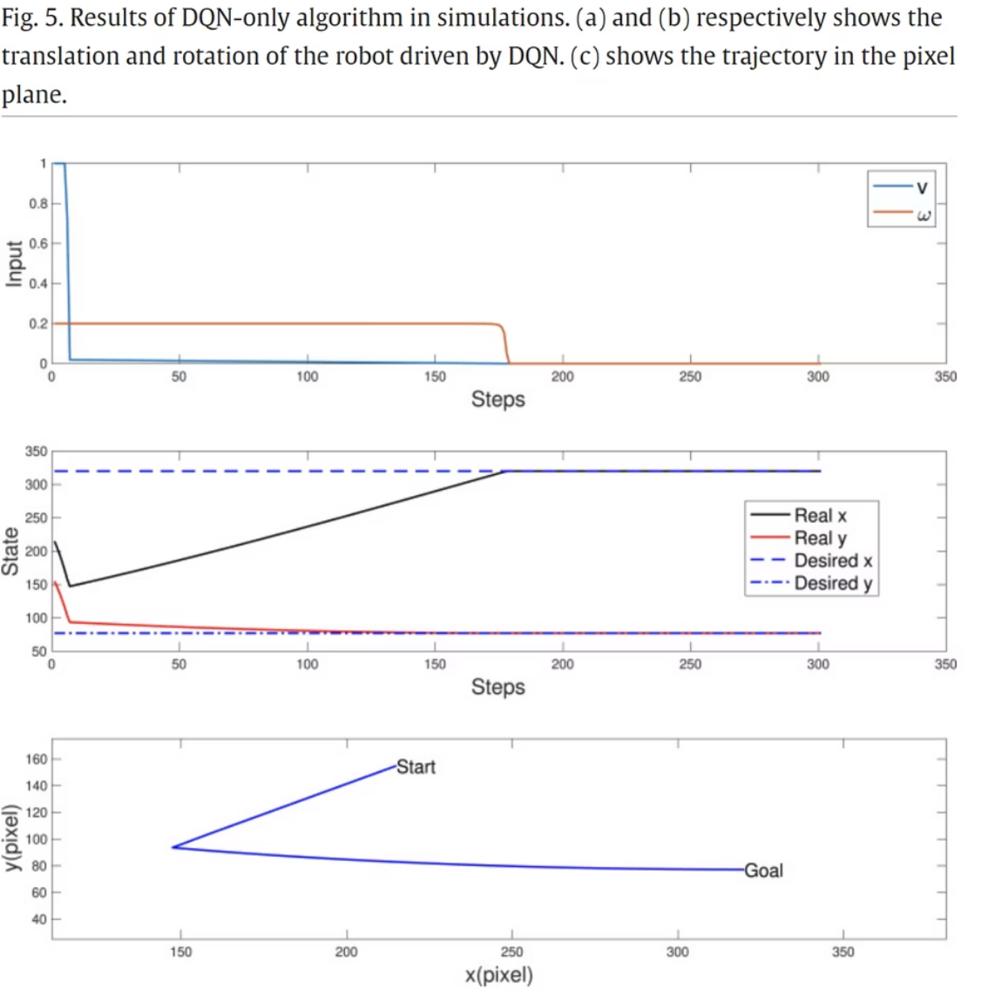
SOTA LITERATURE-LI AT AL(2022)
Core Characteristics:
Fig. 5. Results of DQN-only algorithm in simulations. (a) and (b) respectively shows the translation and rotation of the robot driven by DQN. (c) shows the trajectory in the pixel plane.
The Deep Q-Network takes in current machine states, job queue, and transport availability all at once so it knows exactly what's happening before making each decision.
Its reward balances getting jobs done fast and using transport resources efficiently. If conditions change (e.g. a rush order lands), the DQN shifts focus to optimize the most urgent goal.
By replaying past experiences from a memory buffer and using a stable "target" network, it continually refines its policy without forgetting how to handle new disturbances.
It begins training using simple rules so it makes decent choices immediately. As it learns, it gradually explores alternatives especially when unexpected events occur so it quickly adapts to new shop-floor surprises.
www.sciencedirect.com

Slide 14
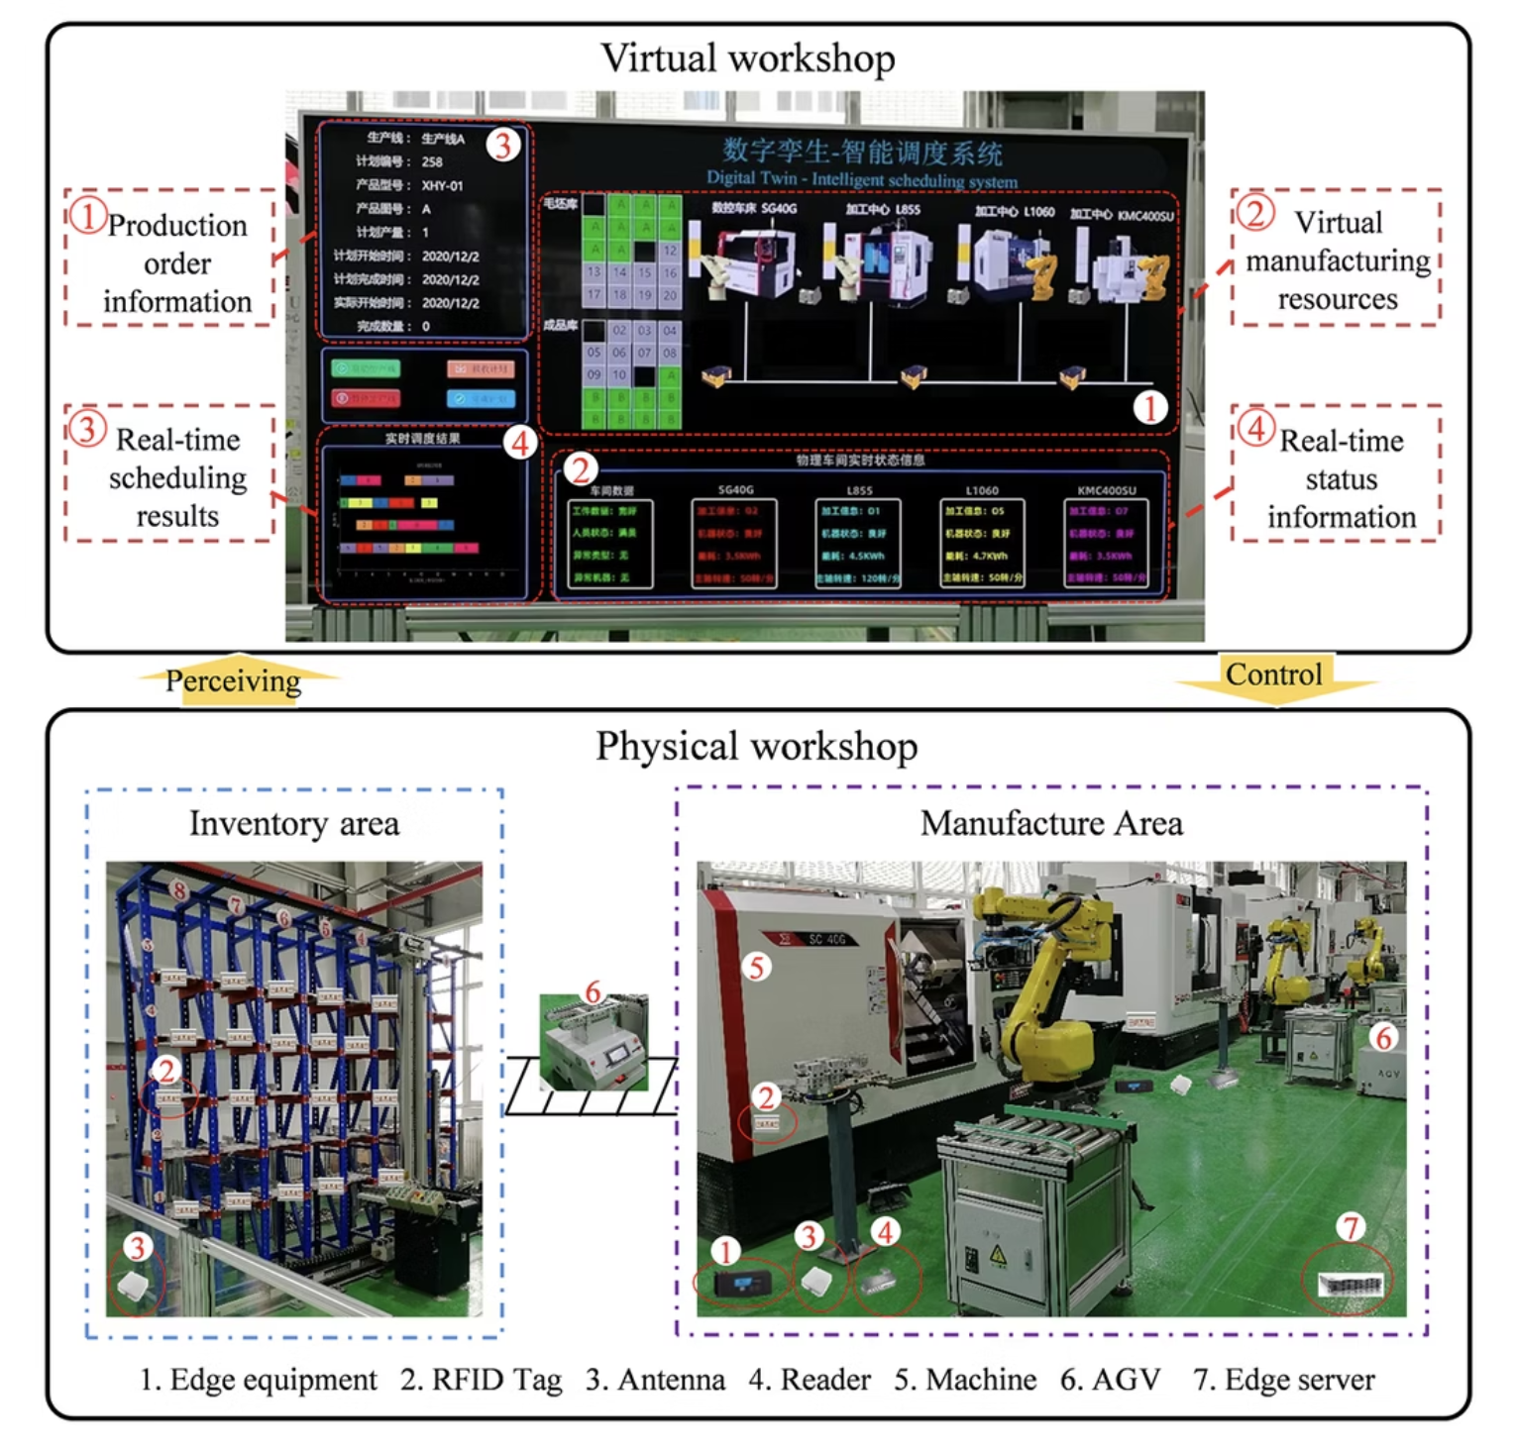
SOTA LITERATURE- XU & XI(2021)
Edge‐Enabled Data Filtering: Modern frameworks place RFID readers and sensors in the shop‐floor's inventory and manufacturing areas, funneling raw data through a local edge server that cleans and aggregates before forwarding minimizing network load and latency.
Local Digital Twin: A virtual workshop mirroring every machine and AGV runs on the same edge infrastructure, continuously syncing with live status feeds to maintain an up-to-date model of production resources.
Real-Time Closed-Loop Scheduling: The digital twin hosts an intelligent scheduler at the edge recomputing job assignments and Gantt-style plans instantly whenever orders change or machines go down, then dispatching updated commands back to the floor.
www.sciencedirect.com

Slide 15
BULLET PROOF TECH STACK
Component
Details
1. Core Runtime & Language
Python • Scheduler logic – paho-mqtt (MQTT client) – DEAP or PyGAD (Algorithm)
2. Messaging & Communication
MQTT Protocol• Broker: Eclipse Mosquitto (local)• Topics:– machines/<ID>/command → dispatch jobs– machines/<ID>/status , /done → feedback
3. Edge Compute & Infrastructure
Edge Server (Host PC or Docker)• Runs:– MQTT broker– Python scheduler service– Machine simulator processes
4. Front-End Dashboard
Node-RED + Dashboard UI• Rapid MQTT integration•Widgets for machine status, job-queue, control buttons

Slide 16
Why This Stack?
Simplicity & Speed: Python & Node-RED minimize boilerplate
Real-Time: MQTT + edge compute ⇒ low latency
Scalable: Modular components can be expanded or swapped out
Prototyping: All tools run on a standard PC; no special hardware required

Slide 17
STRATEGY MOVING FORWARD
Setup: Install Python, MQTT broker, Node-RED, and libs.
Core: Code machine simulators ;test standalone.
Integrate: Scheduler machines via MQTT; dispatch on events.
Dashboard: Build Node-RED UI for status, job injection, controls.
Test & Tune: Run scenarios, measure latency, adjust GA parameters.

Slide 18
WORK SPLIT
Dhrusheek - MQTT Broker setup, Simulator Code
Sreepathy- Integration of DQN to Job Scheduling Algorithm
Thilagan - Setup of Edge nodes with data filtering to be interpreted
Preethi- Dashboard and Data visualisation of simulated results

Slide 19
THANK YOU!

